Slide 1
Chapter 5: Inclusion for Peace, Democracy and Development
Chapter Objectives
After the successful completion of this chapter, you will be able to:
Define Peace, Democracy, and Development
Identify sources of exclusionary practices
Discuss exclusionary practices in the community
Discuss respecting diverse needs, cultures, values, demands, and ideas
Identify conflict emanated from exclusion
Explain the means and benefits of participation of the marginalized group of people
Discuss the democratic principles for inclusive practices
Explain the importance of inclusion for psychosocial development
Elaborate on the importance of inclusion for economic development
Discuss the importance of inclusion for peace

Slide 2
5.1. Definition of Peace, Democracy and Development
Inclusive education is at the heart of any strategy for peace-building, democracy, and development.
Through inclusive educational values, skills, and knowledge that form the basis of respect for human rights and democratic principles can be developed.
The rejection of violence and a spirit of tolerance, understanding, and mutual appreciation among individuals, groups, and nations can be enhanced through inclusive education
Inclusiveness is the first phase towards increasing participation and fights for social justice for people with disabilities, vulnerable and general populations
Inclusive developments in all sectors encourage greater acceptance of diversity of gender, culture, language, economy, and politics; and the formation of more tolerant, equitable, and cohesive societies; simply put, creates an inclusive society

Slide 3
5.2 Inclusion for Peace
Peace is defined as creating mutual understanding, and positive relationships between individuals and groups (heterogeneous groups).
This means developing interpersonal peace through deep respect for other persons, justice, tolerance, and cooperation.
Human beings are interconnected and should be free from negative force, fear, hatred, anger, tension, violence stress, anxiety, and any kind of destruction.
Peace makes the mind quiet and calm prevents anxieties, worries, stress, and fears, and awakens inner strength and confidence, develops freedom, happiness, love, joy, justice, and gratitude.
Inclusive education is a foundation for inclusiveness in all aspects of life.

Slide 4
What is the importance of Inclusive education?
Inclusive education is crucial/important for:
Fostering education:-that promotes the values, attitudes, and behavior inherent in a culture of peace, including conflict prevention and resolution, dialogue, consensus-building, and active non-violence;
Promoting sustainable economic and social development:- by targeting the eradication of poverty and social inequalities;
Promoting respect for the Universal Declaration of Human Rights at all levels;
Promoting gender equality in economic, social, and political decision-making;
Fostering democratic participation and citizenship and supporting processes that promote and sustain democracy;
Advancing understanding, respect for cultural diversity, and human solidarity by promoting dialogue among societies;
Supporting participatory communication and the free flow and sharing of information and knowledge in the promotion of a culture of peace;
Promoting international peace and security through activities such as the promotion of general and complete disarmament.

Slide 5
What is the limitation of Exclusion education for a nation?
Exclusion practices in education create an undesirable result for a nation;
Cut people off from full involvement in the economic and social life of their country
Exclusion through horizontal inequalities undermines social cohesion, and shared values;
Increase disparities in wealth and income;
Difficult to enable people to have a sense that they are engaged in a common enterprise, facing shared challenges, and that they are members of the same community;
Dominant ethnic groups control state resources and may discriminate against minority groups in terms of access to social resources e.g. education & employment opportunities;
Large horizontal inequalities may instead increase group cohesion among those who are marginalized, facilitating mobilization for conflict;
Increase the risk of the outbreak of conflict-:-due to discrimination on the basis of gender, age, class, religion, disability, poverty, geographical location etc.

Slide 6
5.3. Sustaining Peace
It is important to expand formal and informal inclusive education with the aim of creating an inclusive society with the following competencies in young and adult populations:
Skill of sifting the truth from propaganda/bias that surrounds them in every culture
Respect for the wise use of resources and appreciation for more than just the materialistic aspects of quality of life
Respect for different points of view and the ability to see the world through the eyes of others
Skills to resolve conflict in non-violent ways
The desire and ability to participate in shaping society, in their own community, their nation, and the world.

Slide 7
5.3.1.Steps in Building peace
Fostering inclusion:- ensuring access to justice, strengthening the social fabric, and delivering good governance have repeatedly been shown to be essential to achieving development outcomes.
Reaffirm a commitment to human rights:- the foundation for human dignity and just societies (Human rights, including economic, social, and cultural rights based on equality and inclusion)
Foster social resilience by strengthening inclusion and addressing inequality.
Think local and act global: recommit to multilateralism as a safeguard for the most vulnerable
Sustainable Development Goals (only 40% of the fostering the external drivers of peace, justice, and inclusion required)
Protect and support civil society in fostering sustainable peace: Social, political, and economic changes that contribute to increasing peace are more robust if they are owned, implemented, and sustained by local actors, including youth and women.

Slide 8
5.4. Inclusion for Democracy
Democracy is a great philosophy of inclusion that is born and grown in inclusive schools.
It means the rule of the people, by the people, for the people; and where ―people are to mean all human beings, regardless of the diversities.
Democratic schools are an educational ideal in which democracy is both a goal and a method of instruction.
It brings democratic values to education and can include self-determination within a community of equals, as well as such values as justice, respect, and trust in diversities

Slide 9
5.5. Inclusion for Development
The word development is widely used to refer to a specified state of advancement or growth a new and advanced idea, profession, physical, mental, product; or an event that constitutes a new stage under changing circumstances.
Development is a positive growth or change in economical, social, and political aspects of a country.
Inclusive development is a process that occurs when social and material benefits are equitably distributed across divides in society (Hikey, 2015)
Inclusion development is voice and power to the concerns and aspirations of otherwise excluded groups (Johnson and Anderson 2012).
Inclusive development also has an ―integral focus on the achievement of equity and the rights of citizenship (Hickey, 2013).

Slide 10
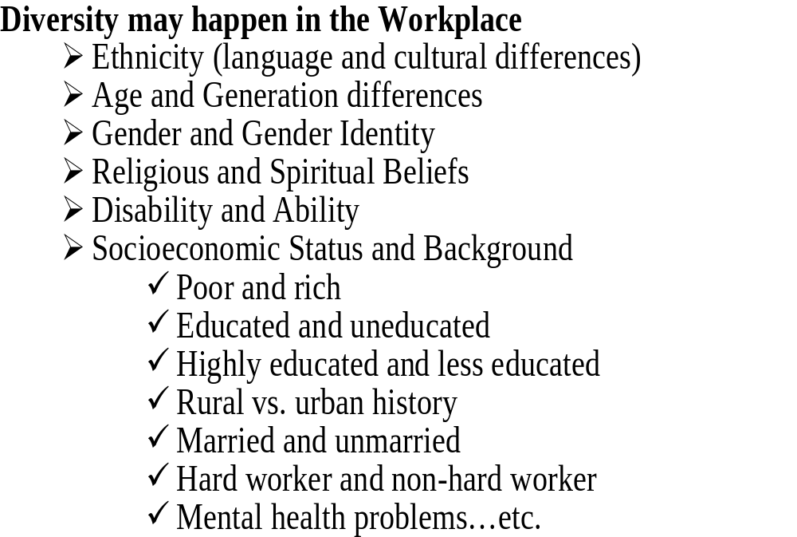
5.6. Respecting diverse needs, cultures, values, demands, and ideas
These include race, ethnicity, age, ability, language, nationality, socioeconomic status, gender, religion, or sexual orientation.
The biggest diversity issues in the workplace are the following:
Acceptance and Respect
Accommodation of Beliefs
Ethnic and Cultural Differences
Gender Equality
Physical and Mental Disabilities
Generation Gaps
Language and Communication

Slide 11
5.7 Cultural Diversity
The major categories of cultural diversities are the following;
Ethnic diversity:- a construct that describes a person's cultural identity- nationality, regional culture, ancestry, and language.
Cultural diversity:- what language someone speaks, religion, holidays celebrated, ethnic identity, culture and the like helps us recognize and respect
Religious diversity:- in the modern period, debates are common over the extent to which religious, economic, or ethnic aspects of a conflict predominate in a given conflict.
Gender differences:- the role of a male or female in society.
Marginalized group of people:- people may be marginalized on the basis of social, gender, cultural, ethnic, economic, social order, beliefs, and other factors.

Slide 12
Chapter summary questions
What are Peace, Democracy, and Development, and explain the relationship
Explain sources of exclusionary practices in Ethiopia
Explain your views in terms of the concepts of respecting diverse needs, cultures, values, demands, and ideas
Explain the conflict that can be emanated from exclusion.
Explain the means and the benefits of participation of the marginalized group of people
Discuss the democratic principles for inclusive practices
Explain the importance of inclusion for psychosocial development, economic development and peace

